Slide 1
EXPLORATORY data analysis
Abirami Sukumaran, Divyansh Chahar

Slide 2
EDA
Exploratory Data Analysis is an approach that employs variety of graphical techniques for uncovering data insights in the following aspects:
Data Set Understanding
Data Structure
Important Variables
Outliers and Anomalies
Assumptions
Dependencies
Relationships
Correlation
Patterns

Slide 3
Techniques and tools
The EDA process itself is not a technique. It is rather identified as a personal philosophy or an attitude towards understanding and perceiving data using various techniques and tools available. Some of the most popular are listed below:
Heat Map
Box Plot
Histogram
Multi-variate charts
Pareto Chart
Scatter Plot
Run-Sequence (Time Sequence Plot)
John Tukey is the Mathematician behind EDA.

Slide 4
Points to note
Some of the most common EDA techniques are covered
Graph representations are samples only, not real live data
Python is used for code snippets
Details and examples are at high level, overview
Customization, alternative methods and other options are possible for all topics covered here

Slide 5
Box plot (box and whisker plot)
Box plots are used to convey the measures of spread and center of a dataset
Box plots may also have lines extending from the boxes (whiskers) indicating variability outside the upper and lower quartiles, hence the terms box-and-whisker plot and box-and-whisker diagram
Measures of spread include Inter Quartile Range (IQR) and Mean
Measure of center include Average and Median
A boxplot is a standardized way of displaying dataset based on a five-number summary: Minimum, Maximum, Sample Median, and the First and Third Quartiles
Minimum : the lowest data point excluding any outliers
Maximum : the largest data point excluding any outliers
Median (Q2 / 50th percentile) : the middle value of the dataset
First quartile (Q1 / 25th percentile) : also known as the lower quartile qn(0.25), is the median of the lower half of the dataset
Third quartile (Q3 / 75th percentile) : also known as the upper quartile qn(0.75), is the median of the upper half of the dataset
Interquartile range (IQR) : is the distance between the upper and lower quartiles
Any data not included between the whiskers should be plotted as an outlier with a dot, small circle, or star

Slide 6
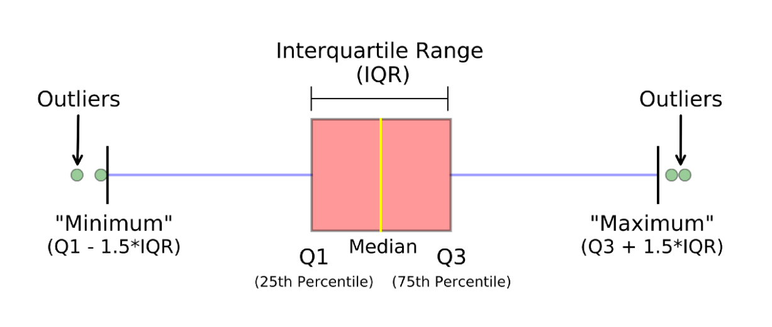
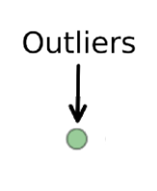
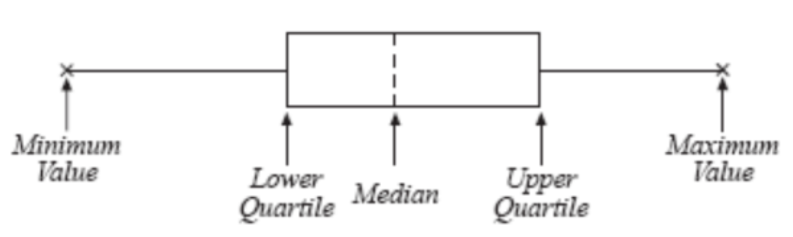
How to plot?

Slide 7

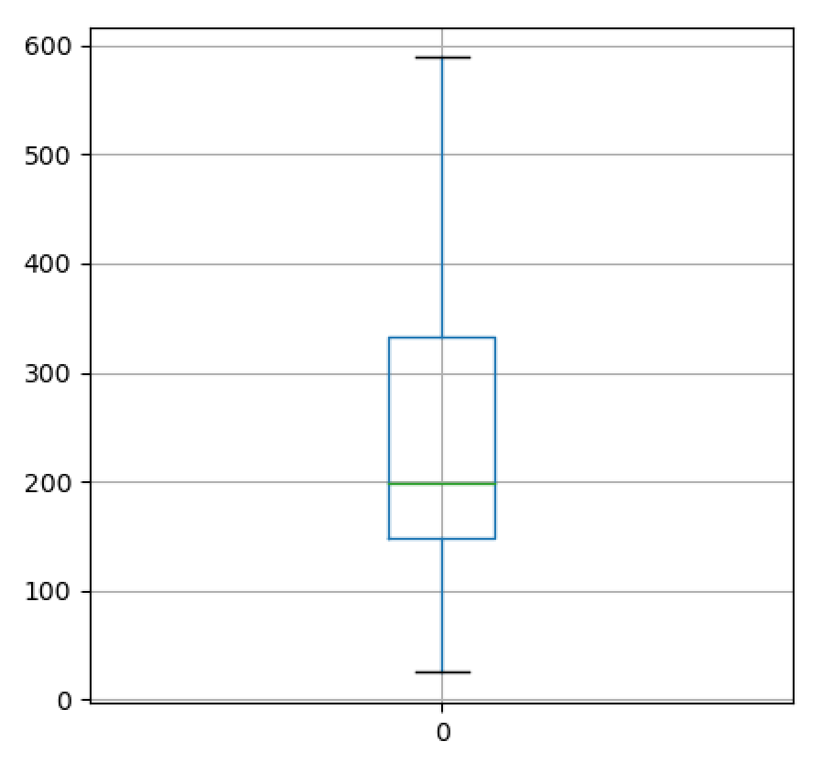

example
Data: lst = [25, 145, 145, 148, 178, 178, 198, 201, 222, 210, 565, 589, 485, 333, 358, 158, 25]
Plot:
Box Plot for sample data on the right
Snippet:
import pandas as pd import seaborn as sns import matplotlib.pyplot as plt lst = [25, 145, 145, 148, 178, 178, 198, 201, 222, 210, 565, 589, 485, 333, 358, 158, 25] df = pd.DataFrame(lst) df.boxplot(column = 0) plt.show()

Slide 8
Multivariate charts
Multivariate data analysis is a set of statistical models that examine patterns in multidimensional data by considering several data variables at once
A practical use-case example for this would be a method to analyze correlations in data. The non-multivariate case of regression is the analysis between two variables, and it is called a bivariate regression or one variable which is the univariate
Multivariate regression aka multiple regression - consider way more variables
Most of the charts and plots we see in this article are multivariate ones unless specified otherwise

Slide 9
Heat map
A heat map (or heatmap) is a graphical representation of data where the individual values contained in a matrix are represented as colors
It is a technique that shows the magnitude of a phenomenon as color in two dimensions giving obvious visual cues to the reader about how the phenomenon is clustered or varies over space

Slide 10
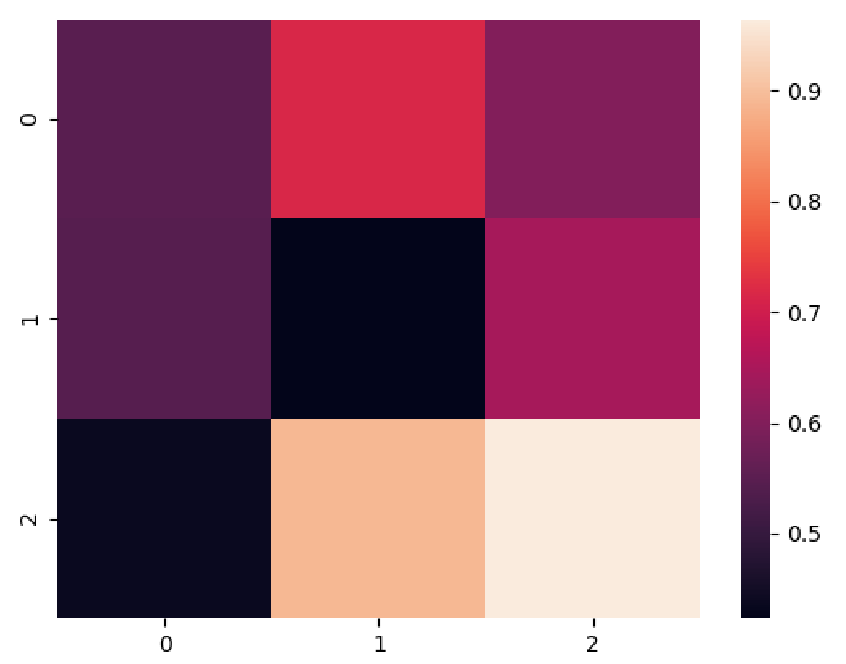
Example
Data:
[[0.5488135 0.71518937 0.60276338]
[0.54488318 0.4236548 0.64589411]
[0.43758721 0.891773 0.96366276]]
Plot:
Heat map for sample data on the right
Snippet:
import numpy as np
import seaborn as sns
import matplotlib.pyplot as plt
np.random.seed(0)
uniform_data = np.random.rand(3, 3)
print(uniform_data)
ax = sns.heatmap(uniform_data)
plt.show()

Slide 11
histogram
The purpose of a histogram (Chambers) is to graphically summarize the distribution of a univariate data set.
Univariate represents that it takes only one numerical variable as input
The variable is cut into several bins, and the number of observation per bin is represented by the height of the bar
Bins are the number of intervals you want to divide all your data into, such that it can be displayed as bars on a histogram (A simple method to roughly calculate how many bins are suitable is to take the square root of the total number of values in your distribution)
Note that the shape of the histogram can be different following the number of bins you set
The histogram graphically shows the following:
Center of the data
Spread of the data
Skewness of the data
Presence of Outliers and
Presence of multiple Modes in the data.

Slide 12
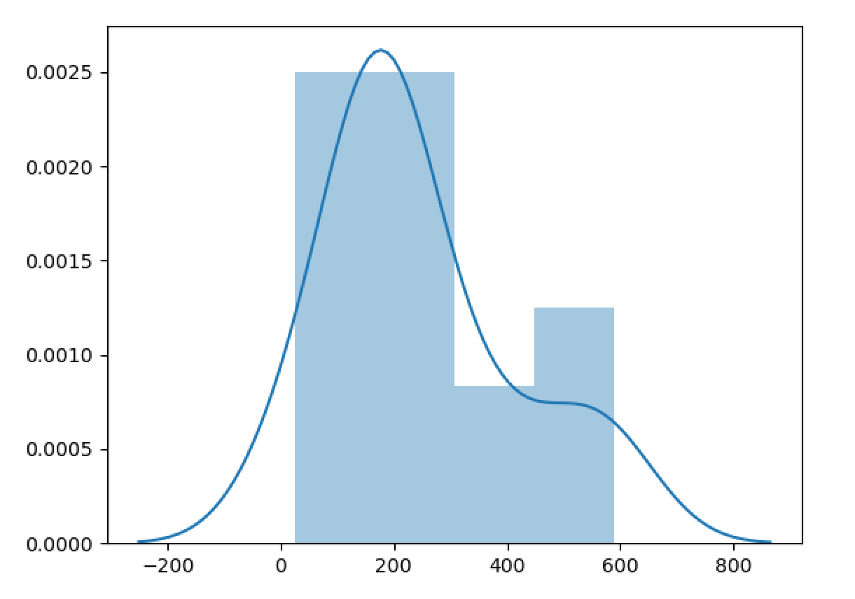
Example
Data:
lst = [25, 145, 145, 148, 178, 178, 198, 201, 222, 210, 565, 589, 485, 333, 358, 158, 25]
Plot:
Histogram for sample data on the right
Snippet:
import numpy as np
import seaborn as sns
import matplotlib.pyplot as plt
lst = [25, 145, 145, 148, 178, 178, 198, 201, 222, 210, 565, 589, 485, 333, 358, 158, 25]
sns.distplot(lst, bins=4)
plt.show()

Slide 13
Scatter plot
A scatter plot (aka scatter chart, scatter graph) uses dots to represent values for two different numeric variables
The position of each dot on the horizontal and vertical axis indicates values for an individual data point
Scatter plots are used to observe relationships between variables
The dots in a scatter plot not only report the values of individual data points, but also patterns
You will often see the variable on the horizontal axis denoted an independent variable, and the variable on the vertical axis the dependent variable
Relationships between variables can be described in many ways: positive or negative, strong or weak, linear or nonlinear

Slide 14
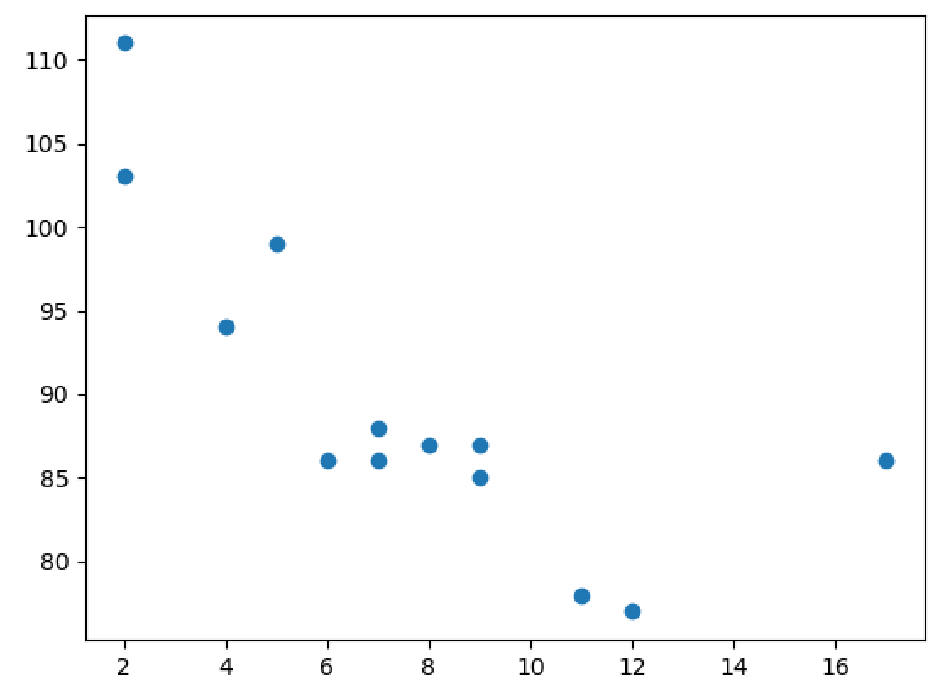
Example
Data:
Age = [5,7,8,7,2,17,2,9,4,11,12,9,6]
Speed = [99,86,87,88,111,86,103,87,94,78,77,85,86]
Plot:
Scatter plot for sample data on the right
Snippet:
import numpy as np
import seaborn as sns
import matplotlib.pyplot as plt
Age = [5,7,8,7,2,17,2,9,4,11,12,9,6]
Speed = [99,86,87,88,111,86,103,87,94,78,77,85,86]
plt.scatter(Age, Speed)
plt.show()
Please note that correlation does not always imply causation. There might be a third variable affecting the plotted variables.

Slide 15
Pareto chart
The Pareto principle (also known as the 80/20 rule, the law of the vital few, or the principle of factor sparsity) states that, for many events, roughly 80% of the effects come from 20% of the causes
Pareto Chart is named after this principle (from Vilfredo Pareto, a noted Italian economist)
A Pareto chart is a type of chart that contains both bars and a line graph, where individual values are represented in descending order by bars, and the cumulative total is represented by the line
The purpose of the Pareto chart is to highlight the most important among a (typically large) set of factors
Real world Example: In quality control, it represents the most common sources of defects, the highest occurring type of defect, or the most frequent reasons for customer complaints and so on

Slide 16
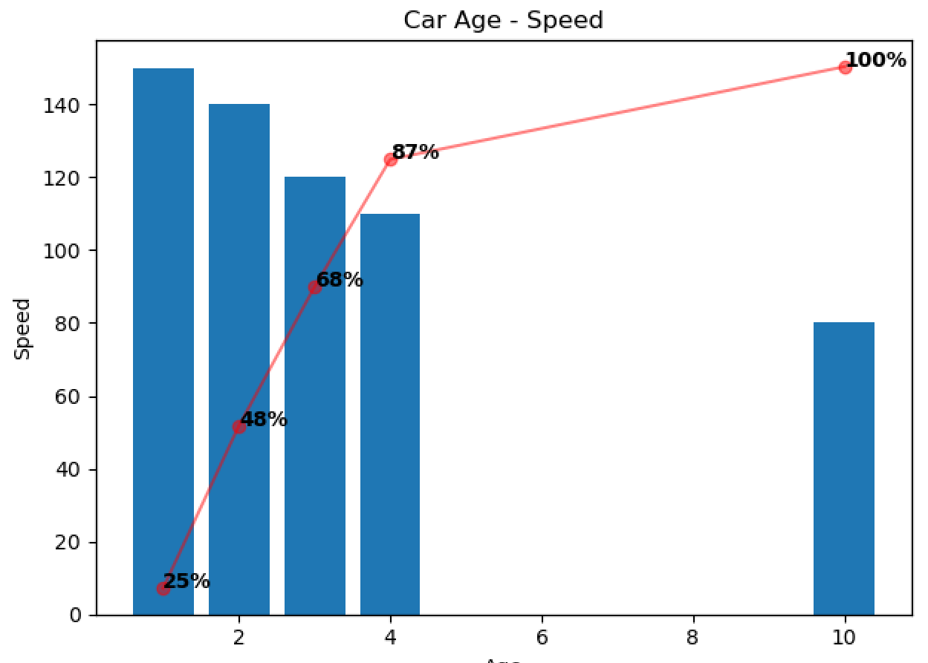
Example
Data:
'Age': [10, 4,3 , 2, 1],
'Speed': [80, 110, 120, 140, 150]
Plot:
Pareto chart for sample data on the right
Snippet:
import pandas as pd
import seaborn as sns
import matplotlib.pyplot as plt
from matplotlib.ticker import PercentFormatter
df = pd.DataFrame({
'Age': [10, 4,3 , 2, 1],
'Speed': [80, 110, 120, 140, 150]
})
pareto_plot(df, x='Age', y='Speed', title='Icecream Flavor Sales’)
*pareto_plot method definition required
As you can see, cars of age 1,2,3 and 4 contribute to 87% of high-speed cars

Slide 17
Run sequence plot
A run chart, also known as a run-sequence plot is a graph that displays observed data in a time sequence
It is a form of line chart as the data displayed represent some aspect of the output or performance of a business process
This is also an easy way to graphically summarize a univariate data set
With run sequence plots, shifts in location and scale are typically quite evident
Outliers can easily be detected

Slide 18
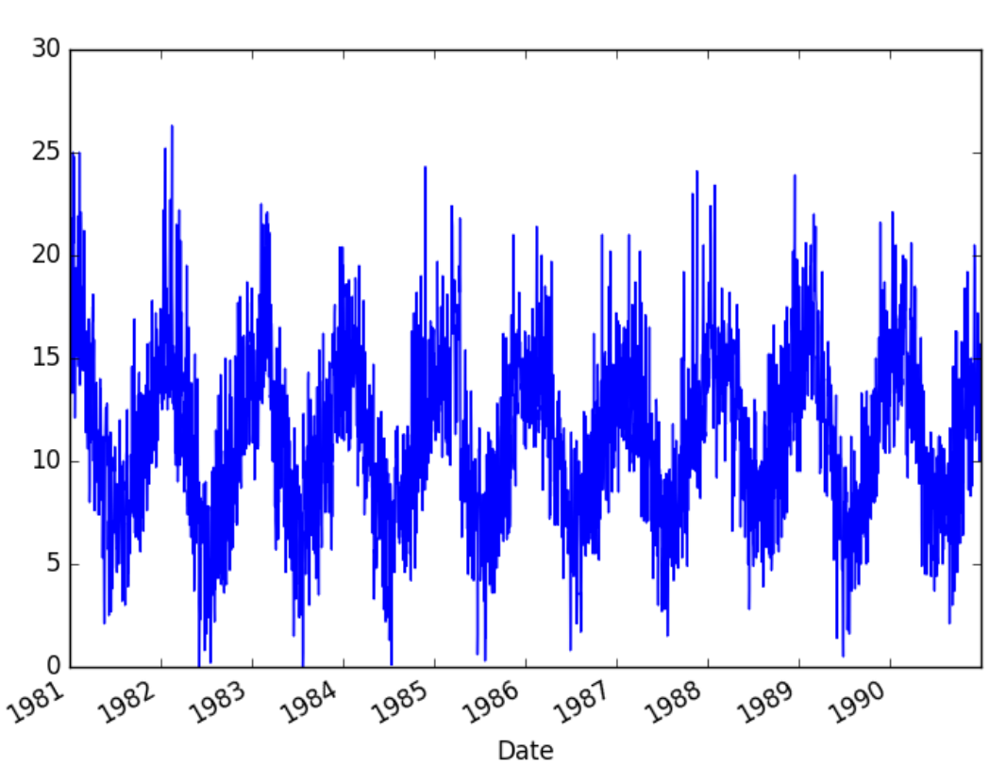
Example
Data:
'Date': ['1981-01-01 20.7', '1981-01-02 17.9','1981-01-03 18.8' , '1981-01-04 14.6', '1981-01-05 15.8'],
'Temp': [20.7, 17.9, 18.8, 14.6, 15.8]
Plot:
Run Sequence chart for sample data on the right
Snippet:
series.plot(style='k.’)
plt.show()

